Slide 1

Professional Learning Communities: 2nd Meeting
How can differentiation be used to ensure the needs of all students are being met?

Slide 2
Overview of today
1st section:
I’ll go through differentiation examples that you could use in the next two weeks
2nd Section:
The action research I’ll be carrying out will involve ways to recruit, train and monitor the effectiveness of mentoring within a school setting, in small groups we will look at what has been done and what could be done in the next 2 weeks

Slide 3
Scan this for today’s Meeting’s

Slide 4
 | Room | Key Question/ Theme | Facilitator | Strand A Group Members |  | Room | Facilitator | Strand B Group Members
A1 | A101 | How can differentiation be used to ensure the needs of all students are being met? | Paddy Brannac | arya_chinna@cic-edu.cn (Econ and Bus) wei.yue@ulink.cn (Maths) irene.tsindos@cic-edu.cn (Eng and Chin) lucy.liu@ulink.cn (Eng and Chi) yan.chen@cic-edu.cn (Maths) wenbo_ye@cic-edu.cn (Chem and Bio) edith.wang@ulink.cn (Chem and Bio) wei.emile@ulink.cn (P.E) patrick.meinel@ulink.cn (Phys) | B1 | A201 | Selina Ning | al.pabelic@ulink.cn (Maths) elin.morris@ulink.cn (Eng and Chin) sunny.qin@cic-edu.cn (Maths) amy.mei@cic-edu.cn (Maths) jack.li@cic-edu.cn (Comp) tito.eguia@ulink.cn (P.E) tingting_li@cic-edu.cn (Chem and Bio) yonge.huang@cic-edu.cn (Phys)
A2 | A102 | How can formative assessment be used effectively to enhance student progress? | Hudson Cao | charlie_shao@cic-edu.cn (Econ and Bus) maria.samblaseno@ulink.cn (Phys) xiaojin.zeng@cic-edu.cn (Maths) laura.jiang@ulink.cn (Chem and Bio) Lisa.Wu@cic-edu.cn (Phys) michael_falvella@cic-edu.cn (Hum) lance.farrelly@ulink.cn (Maths) | B2 | A202 | Andy Jones | zoe.huang@ulink.cn (Phys) mio_eco@sina.com (Econ and Bus) robert.jewison@cic-edu.cn (Econ and Bus) phoebe_guo@cic-edu.cn (Maths) jing.zhang@ulink.cn (Chem and Bio) Jessica.Liang@cic-edu.cn (Phys)
A3 | A103 | What strategies can be used to support SEN learners? | Adam Romano | irina_banari@cic-edu.cn (Hum) tiago.silva@ulink.cn (P.E) Sophie.xu@ulink.cn (Chem and Bio) elline_tao@cic-edu.cn (Econ and Bus) aj.zhao@ulink.cn (Econ and Bus) sean.qian@ulink.cn ( Phys) | B3 | A203 | Helen Chen | darjes.roland@cic-edu.cn (Hum) louis_diang.a@cic-edu.cn (Hum) ana.silva@ulink.cn (P.E) amy.mei@cic-edu.cn (Maths) merlin.zhuo@ulink.cn (Chem and Bio) adam.liu@ulink.cn (Phys) hui_xu@cic-edu.cn (Phys)
A4 | A104 | How can technology be effectively integrated into the classroom to engage 21st century learners? | Bryan Tee | carwyn.ball@ulink.cn (Maths) sam.simona@cic-edu.cn (Chem and Bio) erin.gorelick@ulink.cn (Eng and Chin) darren.he@cic-edu.cn (Comp) lucy_yu@cici-edu.cn (Comp) myko.li@cic-edu.cn (Hum) weizhi_xu@cic-edu.cn (P.E) grace_lin@cic-edu.cn (Maths) marius.bodochi@ulink.cn (Maths) | B4 | A204 | Tingting Song | penny.liu@ulink.cn (Eng and Chin) yanming.tan@ulink.cn (Chem and Bio) sharyn.loy@ulink.cn (Econ and Bus) Doohee.kim@cic-edu.cn (Maths) kelly.liu@ulink.cn (Comp) sean.daniel@cic-edu.cn (Eng and Chin) muzafar.malikov@cic-edu.cn (Phys) Maggie_hu@cic-edu.cn (Maths) jim_zhang@cic-edu.cn (Phys)
A5 | A105 | What strategies can be used to give meaningful feedback that positively impacts on student outcomes? | Stuart Leighton | sunny_kim@cic-edu.cn (Chem and Bio) tura.tigist@cic-edu.cn (Eng and Chin) guilherme.koeppel@ulink.cn (Hum) mingyi_cai@cic-edu.cn (Chem and Bio) rutendo.mabunu@ulink.cn (Hum) annie.manumailagi@cic-edu.cn (Eng and Chin) huasu_xu@cic-edu.cn (Maths | B5 | A205 | Dan Hartley | tura.tigist@cic-edu.cn (Eng and Chin) shang.jin@cic-edu.cn (Hum) helen.wang@ulink.cn (Hum) erlinda.fabriaga@cic-edu.cn (Chem and Bio) selina.lyu@ulink.cn (Econ and Bus) cameron.william@cic-edu.cn (Econ and Bus) sherry_hu@cic-edu.cn (Phys)
A6 | A106 | How can data be used effectively to track and monitor student progress? | Shahida Asif | crystal.chen@ulink.cn (Maths) fergal.mcgee@cic-edu.cn (Comp) rain_xu@cic-edu.cn (Chem and Bio) elizabeth@cic-edu.cn (Eng and Chin) fiona_fan@cic-edu.cn (Eng and Chin) betty_liyixiao@cic-edu.cn (Econ and Bus) michael.donovan@ulink.cn (Phys) | B6 | A206 | Zhen Zhen Patrick Duhamel | angela_zhu@cic-edu.cn (Eng and Chin) sophie_zhong@cic-edu.cn (Eng and Chin) vicky.mu@cic-edu.cn (Eco and Bus) rebecca.li@ulink.cn (Eng and Chin) hongyun_li@cic-edu.cn (Eco and Bus) yingnan.wang@cic-edu.cn (Eng and Chin) miguel.oliveira@ulink.cn (P:E) vicky_jiang@cic-edu.cn (Phys)

Slide 5
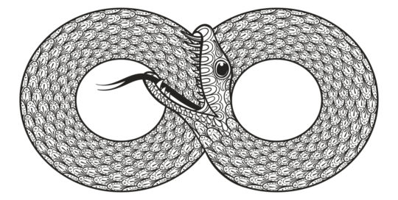
Possible projects – what the teacher can do
Differentiation by | Possible project | Outcome
Content | Investigation into possible different kinds of pretesting, assessment (including formative) and student surveys within subjects and departments | Tried and tested methods to inform teachers at the start on in the middle of the year how to gather useful information about their students
Process | Mentoring research project looking at aspect of selecting, conducting and or evaluating the effectiveness of mentors and mentoring | Methods to select, train and monitor mentors. Ways to effectively implement mentoring in different subjects
Outcome | Investigation into the most time effective online learning platforms | Enhanced skills in using websites like Schoology and other platforms and a report on how to effectively evaluate the amount time needed to learn to use different Virtual Learning Environments

Slide 6
13 Differentiation strategies
Learning/Interest Centres (possibly more useful for younger students)
RAFTS (Role Audience Format Topic) :Writing assignments.
Graphic Organizers : Structure writing projects, to help in problem solving, decision making, studying, planning research and brainstorming
Scaffolded Reading/Writing : 6 different scaffolding strategies from Edutopia
Intelligence Preferences : For an up to date explanation of Garner’s Theory of Multiple Intelligences
Tiered Assignments : For ideas on how to do this, and how to make it invisible to the students
Learning Contracts : Help to promote Self-Directed learning. This link has a good explanation of why and how

Slide 7
1. Steps to creating Internet-Based Learning/Interest Centres
Decide how many centers to create. How many Internet and how many real? Where will the centers be located?
Determine what you want students to learn or be able to do through center activities.
Find Web sites that enhance what you want students to learn. Bookmark these sites
Write a description of the center, providing students with information on what they are expected to do, learn, and produce. Place this near the computer. Give the center a name.
Decide how long center time will be and how many weeks the center will be open.
Share center rules with students on a regular basis. Reward students who obey these rules.
Clearly describe what each center entails and expectations for student learning and work.

Slide 8
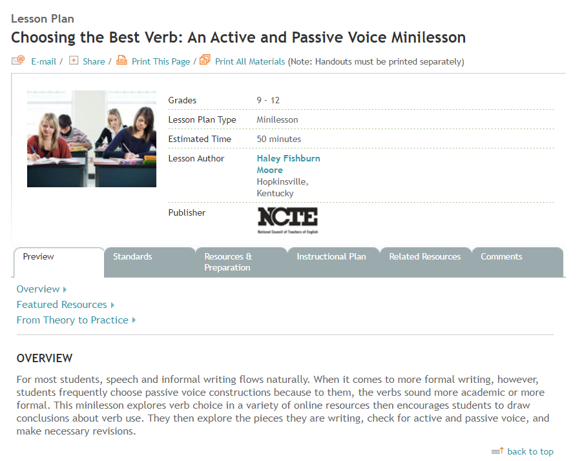
2. RAFTS: Choosing the Best Verb: An Active and Passive Voice Minilesson

Slide 9
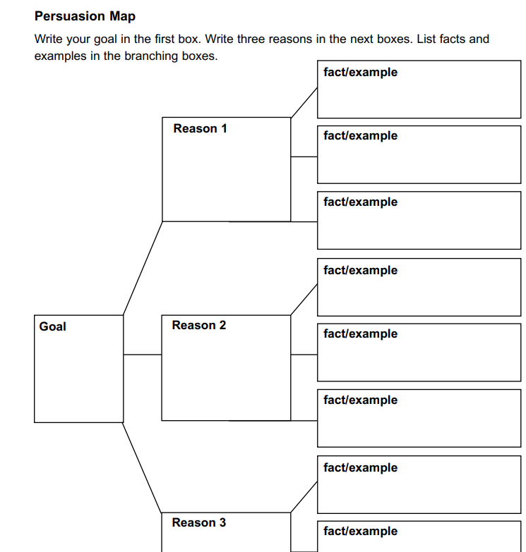
3. Graphic Organizers
Help your students children classify ideas and communicate more effectively. Use graphic organizers to structure writing projects, to help in problem solving, decision making, studying, planning research and brainstorming. Select a Graphic Organizer from the following list of links.

Slide 10
4. Scaffolded Reading/Writing
SHOW AND TELL
TAP INTO PRIOR KNOWLEDGE
GIVE TIME TO TALK
PRE-TEACH VOCABULARY
USE VISUAL AIDS
PAUSE, ASK QUESTIONS, PAUSE, REVIEW

Slide 11
Scaffolded work – Show and tell
Student Fishbowl
This activity requires 60-90 minutes.
Purpose:
Fishbowl activities force participants to listen actively to the experiences and perspectives of a specific group of people. A student fishbowl gives pre-service and in-service educators an opportunity to hear the experiences, ideas, and feedback of current students while giving the students an opportunity to be active in the dialogue on educational equity.

Slide 12

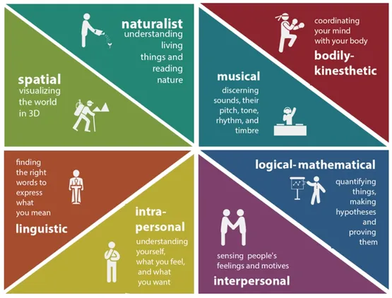
5. Intelligence Preferences

Slide 13
What is Multiple Intelligences Theory?
Howard Gardner's theory of multiple intelligences proposes that people are not born with all of the intelligence they will ever have.
This theory challenged the traditional notion that there is one single type of intelligence, sometimes known as “g” for general intelligence, that only focuses on cognitive abilities.
To broaden this notion of intelligence, Gardner introduced eight different types of intelligences consisting of : Logical/Mathematical, Linguistic, Musical, Spatial, Bodily-Kinesthetic, Naturalist, Interpersonal, and Intrapersonal.
Gardner notes that the linguistic and logical-mathematical modalities are most typed valued in school and society.
Gardner also suggests that there may other “candidate” intelligences—such as spiritual intelligence, existential intelligence, and moral intelligence—but does not believe these meet his original inclusion criteria. (Gardner, 2011).

Slide 14
6. Tiered Assignments
Many teachers use differentiated instruction strategies as a way to reach all learners and accommodate each student’s learning style. One very helpful tactic to employ differentiated instruction is called tiered assignments—a technique often used within flexible groups.
Much like flexible grouping—or differentiated instruction as a whole, really—tiered assignments do not lock students into ability boxes. Instead, particular student clusters are assigned specific tasks within each group according to their readiness and comprehension without making them feel completely compartmentalized away from peers at different achievement levels.

Slide 15
Ways to Structure Tiered Assignments
Challenge Level - Tiering can be based on challenge level where student groups will tackle different assignments. Teachers can use Bloom’s Taxonomy as a guide to help them develop tasks of structure or questions at various levels.
Complexity - When you tier assignments by complexity, you are addressing the needs of students who are at different levels using the same assignment.
Outcome - Tiering assignments by differentiated outcome is vaguely similar to complexity—all of your students will use the same materials, but depending on their readiness levels will actually have a different outcome.
Process - This differentiated instruction strategy is exactly what it sounds like—student groups will use different processes to achieve similar outcomes based upon readiness.
Resources - Tiered assignments can also be differentiated based on product. Teachers can use the Howard Gardner’s multiple intelligences to form groups that will hone particular skills for particular learning styles. F
Resources - Tiering resources means that you are matching project materials to student groups based on readiness or instructional need.

Slide 16
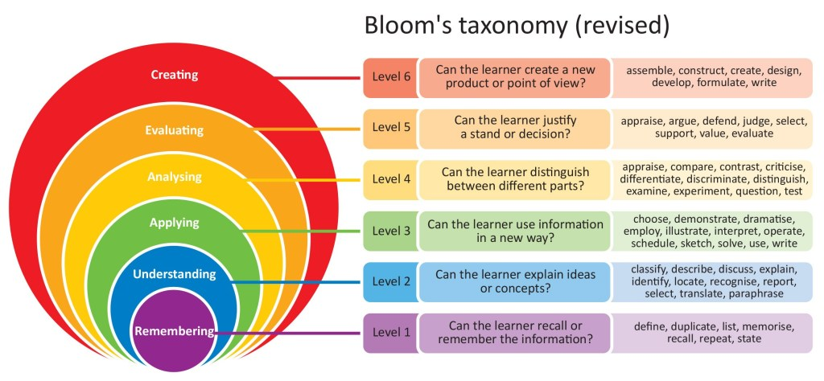

Slide 17
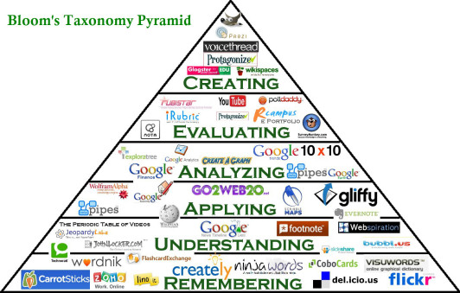

Slide 18
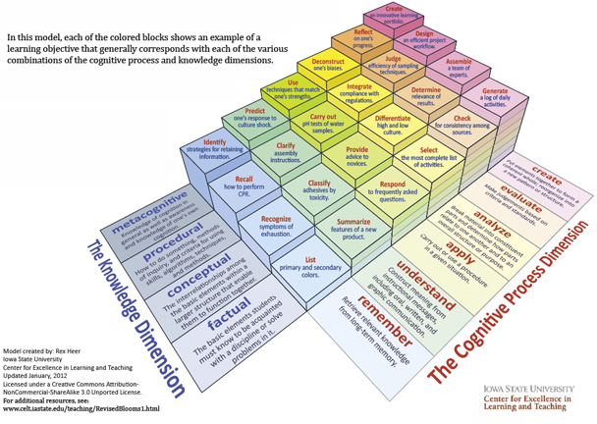

Slide 19
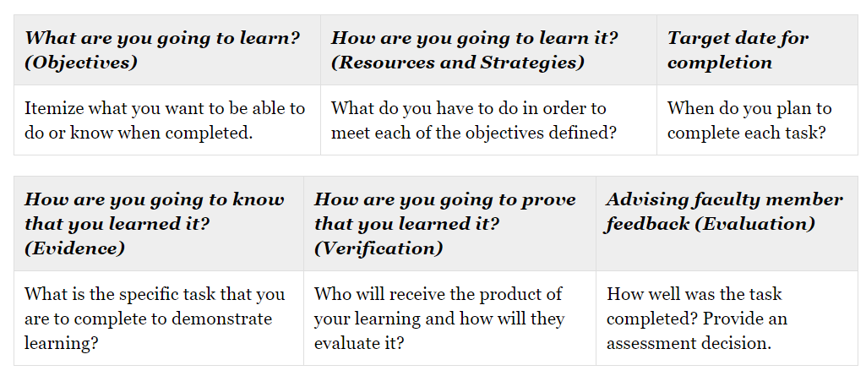
7. Learning Contracts

Slide 20
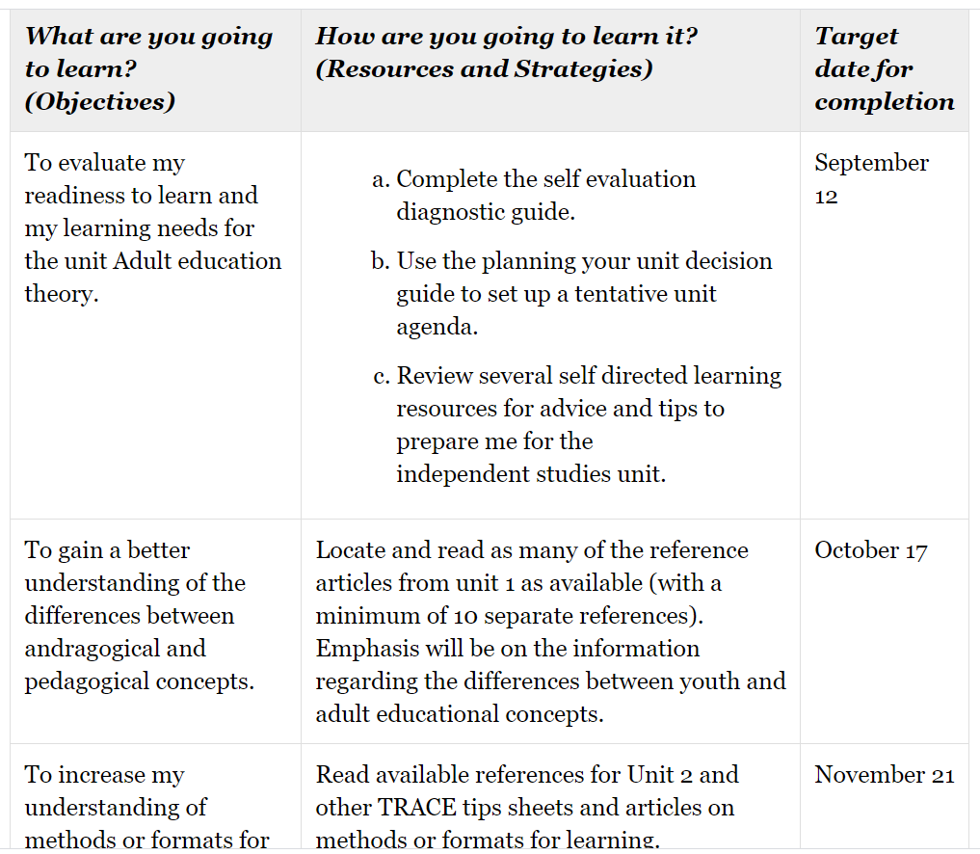
Sample learning contract: Completed

Slide 21
13 Differentiation strategies
Menus : These have categories like “Main Dishes” which the students must all do, but must complete a certain number of, as well as ”Side Dishes” which they can choose 2 of 3 or more options etc. Very adaptable to any subject
Think-Tac-Toe : Students get to chose their activities from a group of 8 or 9 arranged in a specific pattern, to complete the work they have to complete a line of them.(3 in total). This eneables students who finish early to be able to continue the remaining 5 or 6 activities, whilst the least able can complete just 3.
Choice Activities – Allow students to chose the order of a series of tasks. The theory is rooted in psychology, which has been investigated here
Independent Projects These can be particularly effective for gifted stduents
Multiple Means of Action and Expression :Leverages the student’s personal interests to facilitate learning and encourage independent thinking
Small Group Instruction: Teaching and learning in small groups. This link has a good explanation of why and who to do it

Slide 22
Possible projects – what the students bring with them
According to student’s | Possible project | Outcome
Readiness | How ready are student’s investigation into perceived and actual reediness and effect of the difference on learning | Tools to measure and assess readiness in students and teacher’s perceptions on student readiness (e.g. surveys). Tools to analyse data gathered on readiness
Interest | Mapping student interests to student achievement. Investigation into the most effective ways to generate interest in students | Tools to measure student interest in different categories (e.g. surveys, optional activates). Methods to analyse data and interventions that use that data and help cultivate interests. Activities that help inspire students.
Learning Profile | How do student learning preferences predict learning outcomes? How do learning preferences in teachers affect teachers’ perceptions of the most effective learning strategies. Effects of inclusivity actions (gender, culture or intelligence preferences ) on learning outcomes. | Tools to assess our student’s learning preferences. Tools to measure teacher’s learning preferences Effective inclusivity actions in our subjects

Slide 23
Ideas for studies
From maths
ICT PLC INFO Article When the rules of discourse change, but nobody tells you The case of a class learning about negative numbers 2020
From English
ICT PLC INFO Article Action research increasing students’ interests in English grammar lessons university Turkey GulsahOZ1
From Science
ICT PLC INFO Article Increasing high school student interest in science An action research study
From a humanities subject
ICT PLC INFO Article Developing Library GIS Services for Humanities and Social Science: An Action Research Approach

Slide 24
5 essential things to read
ICT PLC INFO Article Defensible Differentiation Why, What, and How Tomlinson 2013 ASL Institute 6-13 v2
ICT PLC INFO Article The goals of differentiation Tomlinson-2008
ICT PLC INFO Article Peer Coaching to Improve Classroom Differentiation Perspectives from Project CLUE
ICT PLC INFO Article How can I find out how my learners view their ability extract from Dweck 2000
ICT PLC INFO Article TxtBk Guiding School Improvement with Action Research Ch1 What Is Action Research Sagor 2000 6Pgs

Slide 25

QR Code for the additional reading resources

Slide 26
Further reading
The Superintendent’s Quality Professional Learning Standards (Approved by the State Superintendent of Public Instruction), California, November 2014
Association of American Educators (AAE) – A US educators organisation
California Department of Education – Curriculum and Instruction Resources. Regulates the second largest English-speaking region in the world
Regional Educational Laboratory (REL) Research Tools
For surveys and other research tools published by the Institute of Education Sciences (IES) from the USA.
http://geoffpetty.com/training-materials/differentiation/
https://minds-in-bloom.com/10-questioning-strategies-to/
https://www.teachertoolkit.co.uk/2018/01/14/differentiation-what-works-and-why/
https://belmontteach.wordpress.com/2014/01/23/better-questioning-thinking-about-thinking/

Slide 27
References
Sager, R. (2000) Guiding School Improvement with Action Research. Chapter 1. ASCD, web version here. Full chapter here.
https://www.giftedpage.org/resources/covid-19-resources/
Differentiation Central (2016) website available here.
https://giftedandtalentedresourcesdirectory.com/
Kelly, D. (2011) Differentiating Instruction for Gifted Learners. Lake Sybelia Elementary
Tomlinson, C. 2013 Defensible Differentiation: Why, What, and How
McCoach, D. B. 2001 Why Try? Factors that Differentiate Underachieving Gifted Students from High Achieving Gifted Students. Office of educational Research and Improvement

