Slide 1
ALvl Chem 5 PPT EQ 2021.m.TZ2.P5.Q1 Thermometric Temperature Changes WS
ALvl Chemistry/2021/m/TZ 2/ Paper 5/Q# 1 /www.SmashingScience.org :o)

Slide 2
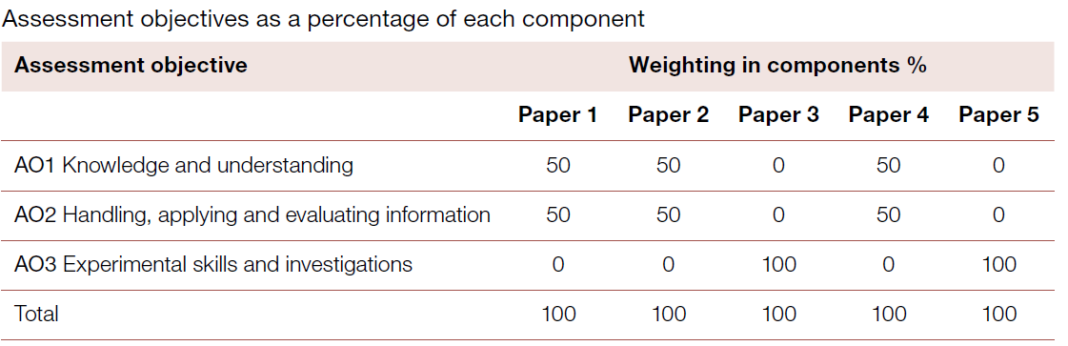
No knowledge or understanding assessed in Paper 5

Slide 3
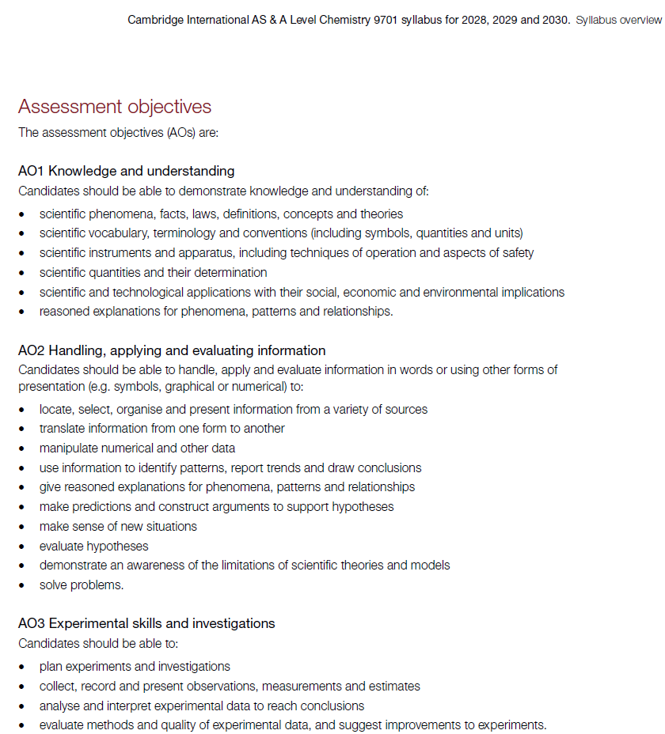
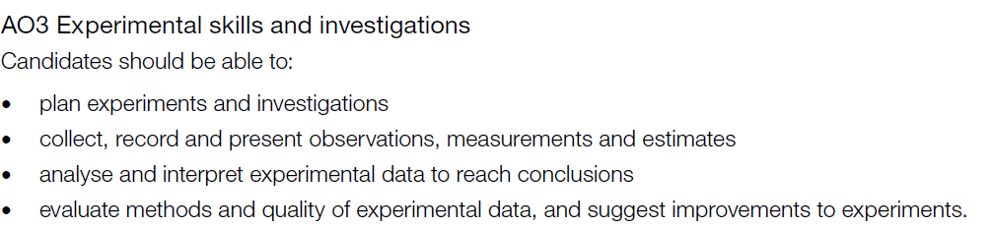

Slide 4
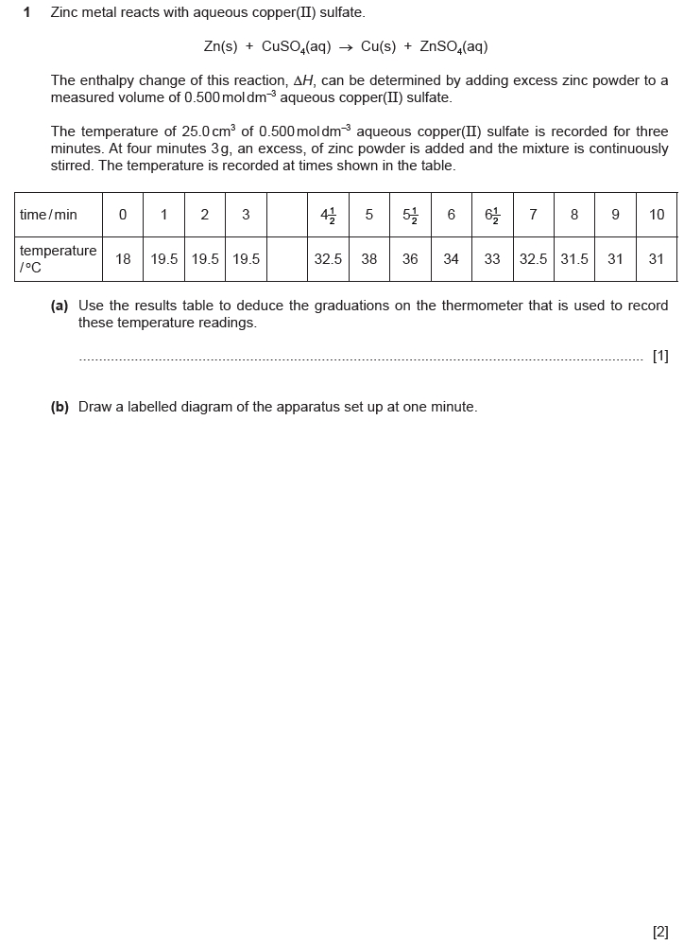
2021.m.TZ2.P5.Q1

Slide 5
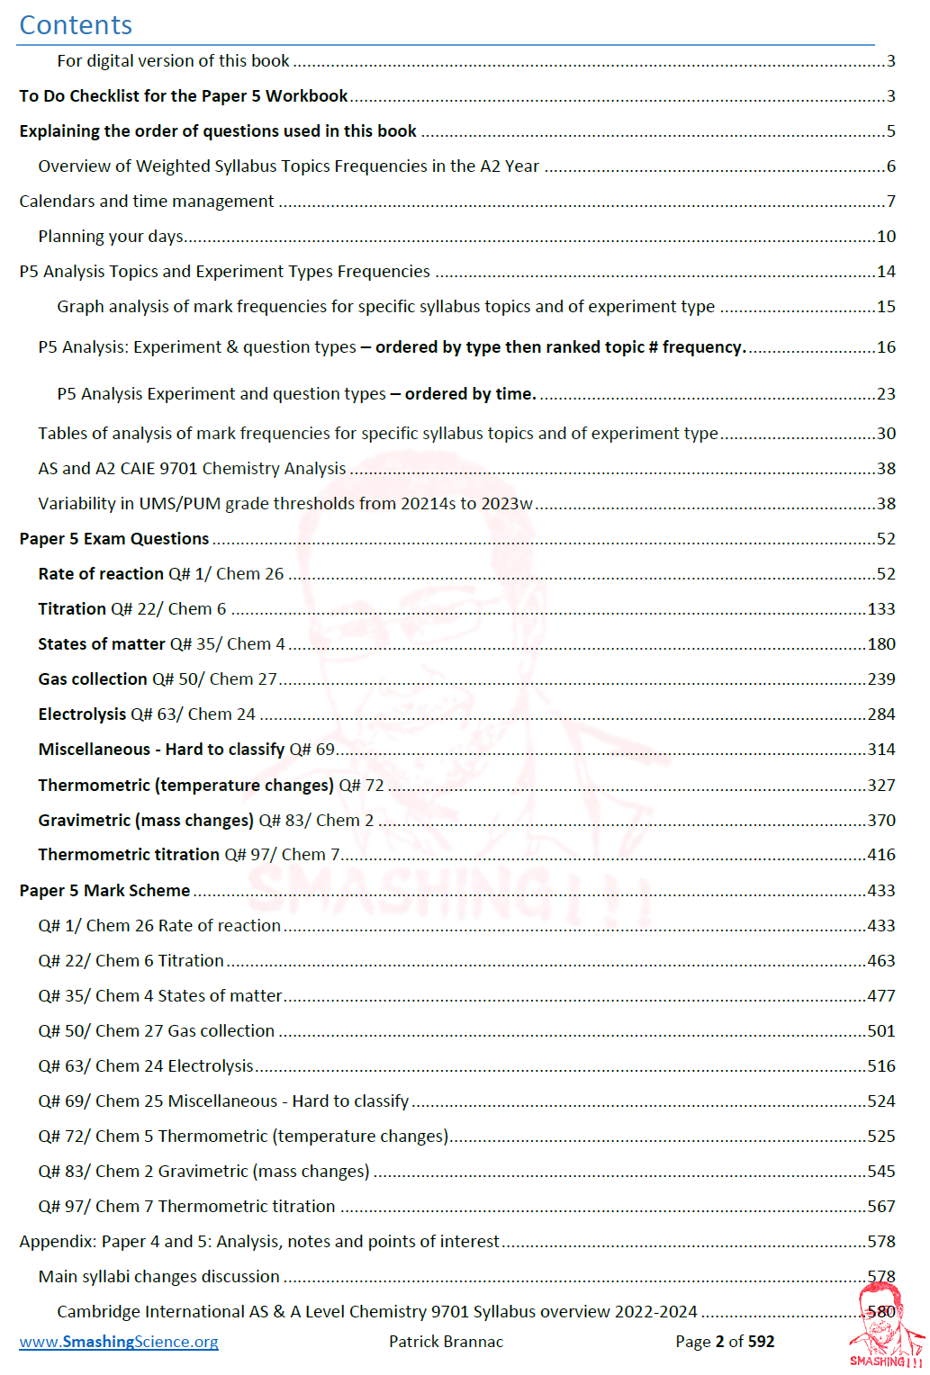
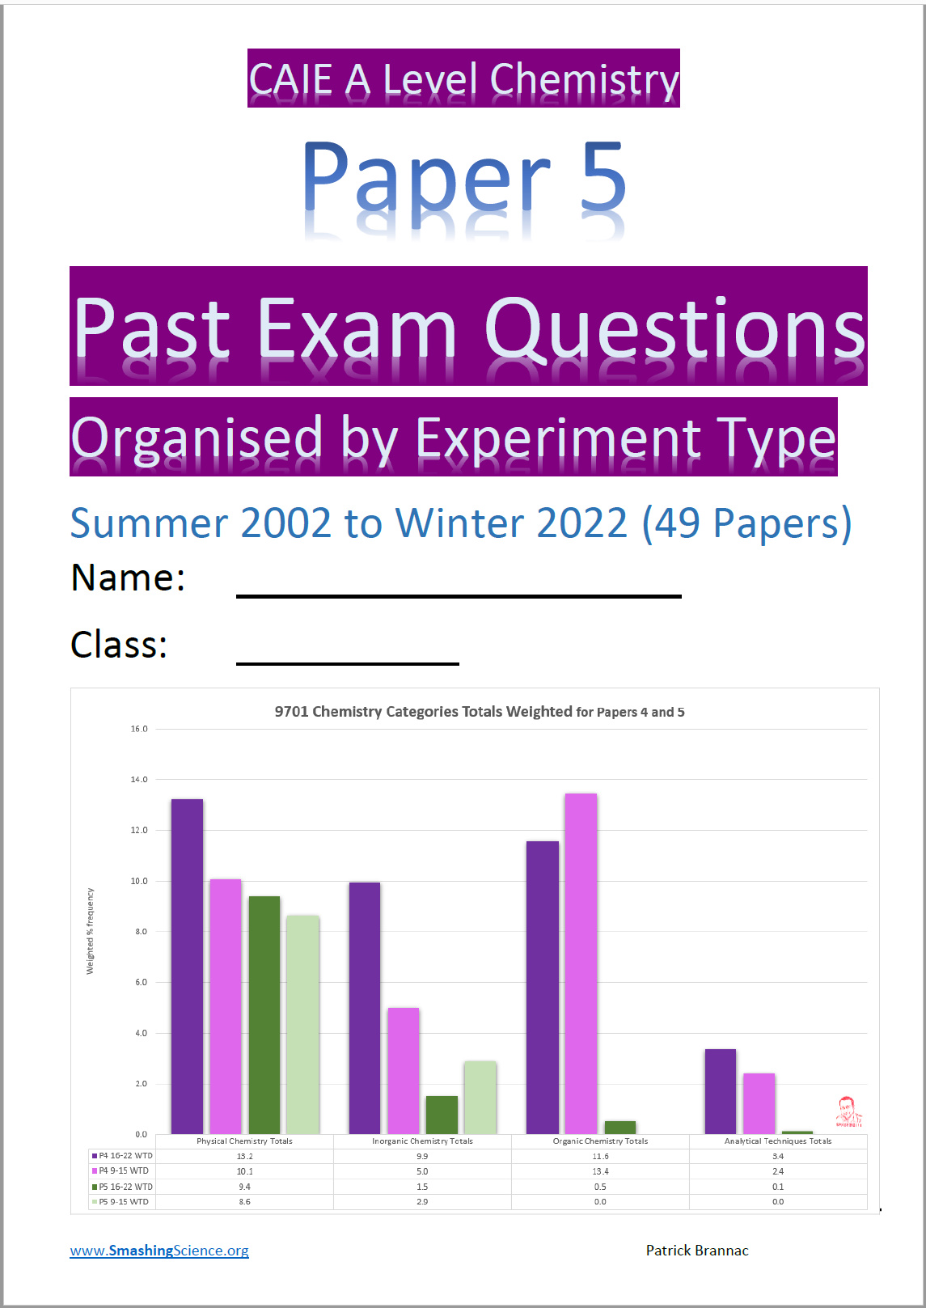

Slide 6
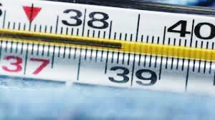
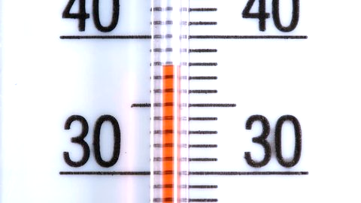
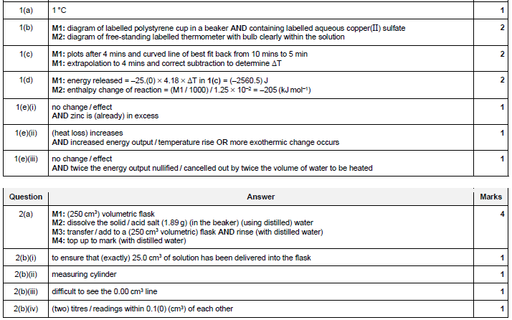
Reading can only deliver:
half of the graduation
of a measuring instrument
(at CAIE A-Level)

Slide 7
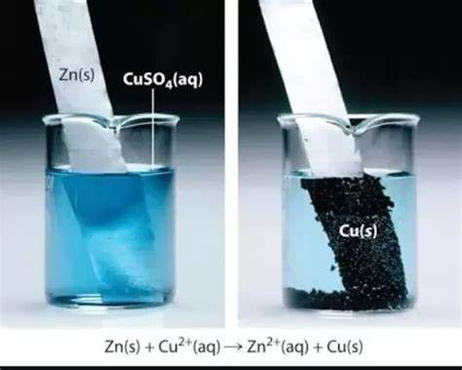
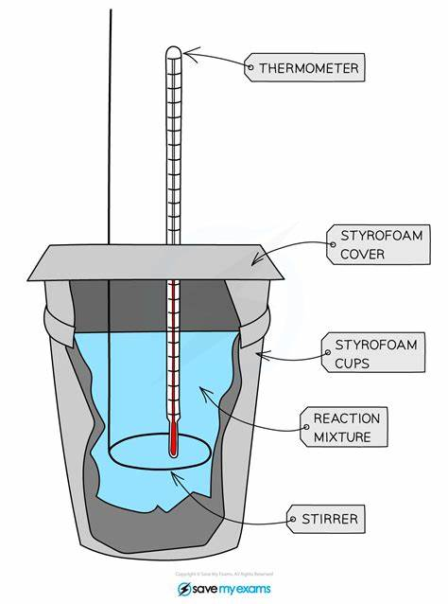

Slide 8
Clamp and clamp stand
Stirrer
Insulated lid (polystyrene)
Insulated cup inside of beaker
(polystyrene cup)
25cm³ of 0.5mol dm⁻³
CuSO₄ (aq)
Thermometer
Thermometer bulb
Zn (s) powder

Slide 9
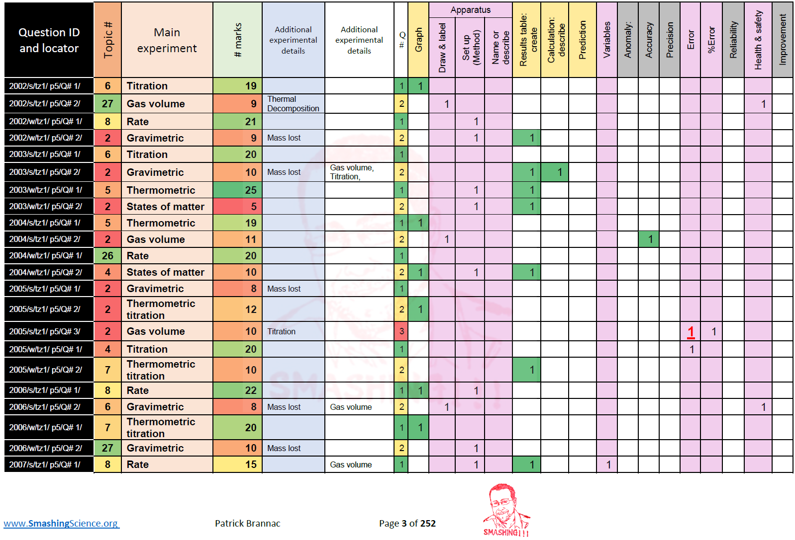
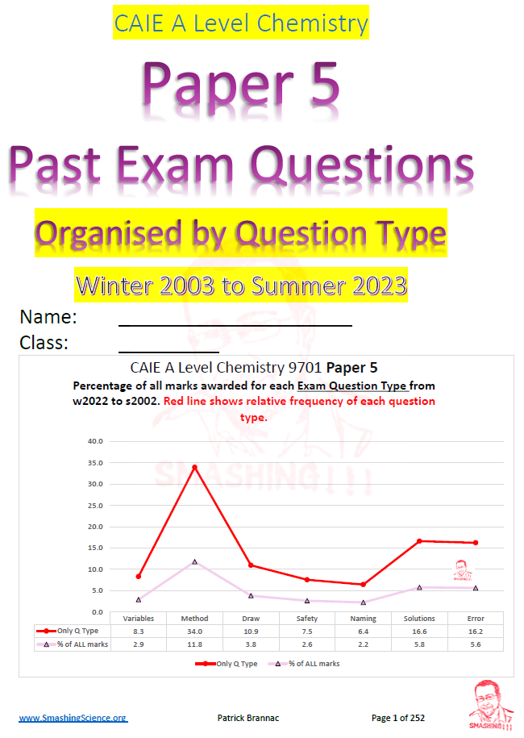
Searching for “Drawing apparatus” questions

Slide 10
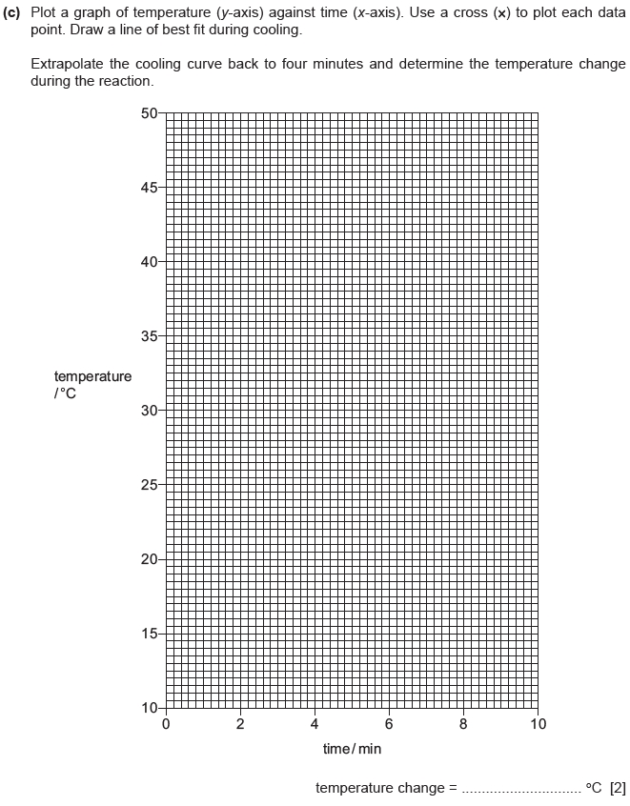
Must be a smooth curve!!!
43.5
Temperature change: 43.5-19.5 =
24.0
19.5
Prepare the graph to add essential details from the results table needed to plot the data given

Slide 11
Searching for “Graphs” questions

Slide 12
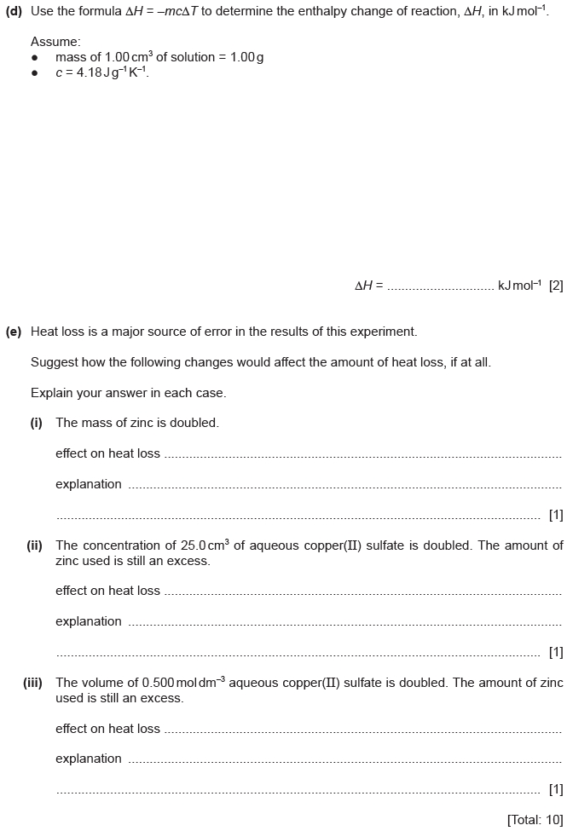
ΔH=- mcΔT
m = 25.0 *1.00 = 25.0 g
ΔT = 24.0 ºC from graph at Q1.(c)
c = 4.18 Jg⁻¹K⁻¹
∴ ΔH= - 25.0 * 4.18 * 24.0
= 2501.0 J
Quick check:
Units are consistent
Oxidation ∴ EXOthermic
- 201
/0.0125
1000
Total moles reacted:
c*v = n
0.5*(25/1000) = 0.0125 moles
Joules
mol⁻¹

Slide 13
ΔH=- mcΔT
m = 25.0 *1.00 = 25.0g
ΔT = 19.5ºC from graph at (c)
c = 4.18 Jg⁻¹K⁻¹
∴ ΔH= - 25.0 * 4.18 * 24.0
= - 2508.0 J
- 201
Question: What are the problems with this calculation?
Specific heat capacity of a solution is ASSUMED to be the same as H₂O(l), but this is usual!
Zinc MASS and energy transferred to it unaccounted for (heat transferred to Zn(s) is ignored)

Slide 15
Heat Loss NOT ACCURACY
∴ No change in heat loss
Zn (s) still in excess ∴ NO CHANGE in amount of exothermic reaction
∴ Heat loss = MORE
Limiting reactant moles =x2, Mass=same but amount of exothermic reaction =x2 ∴ Temperature increase=x2,
∴ no net increase in heat lost measured
Limiting reactant moles =x2, BUT Mass=x2
but increase in heat released is spread out over 2x volume (also 2x mass) ∴ temperature changes = same

Slide 17
ALvl Chemistry/2021/m/TZ 2/ Paper 5/Q# 1 /www.SmashingScience.org :o)

