Slide 1
Learning how to revise more effectively

Slide 2
Is it better to solve a puzzle in a game, or find the solution online?
Which is more satisfying?
Which is more memorable?

Slide 3
Is it better to solve a puzzle in a game, or find the solution online? Which is more satisfying? Which is more memorable?

Slide 4
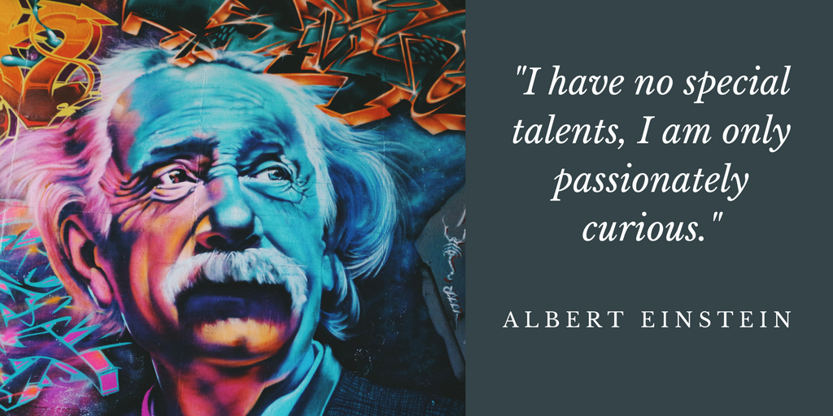
Building interest (and hopefully curiosity)

Slide 5
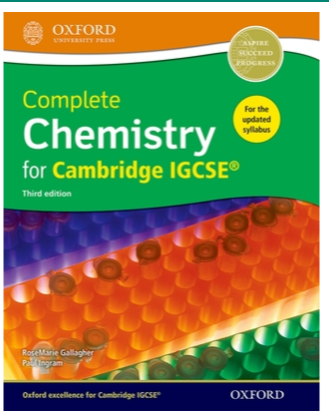
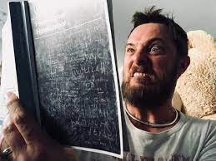
1. read through your notes, & textbook

Slide 6
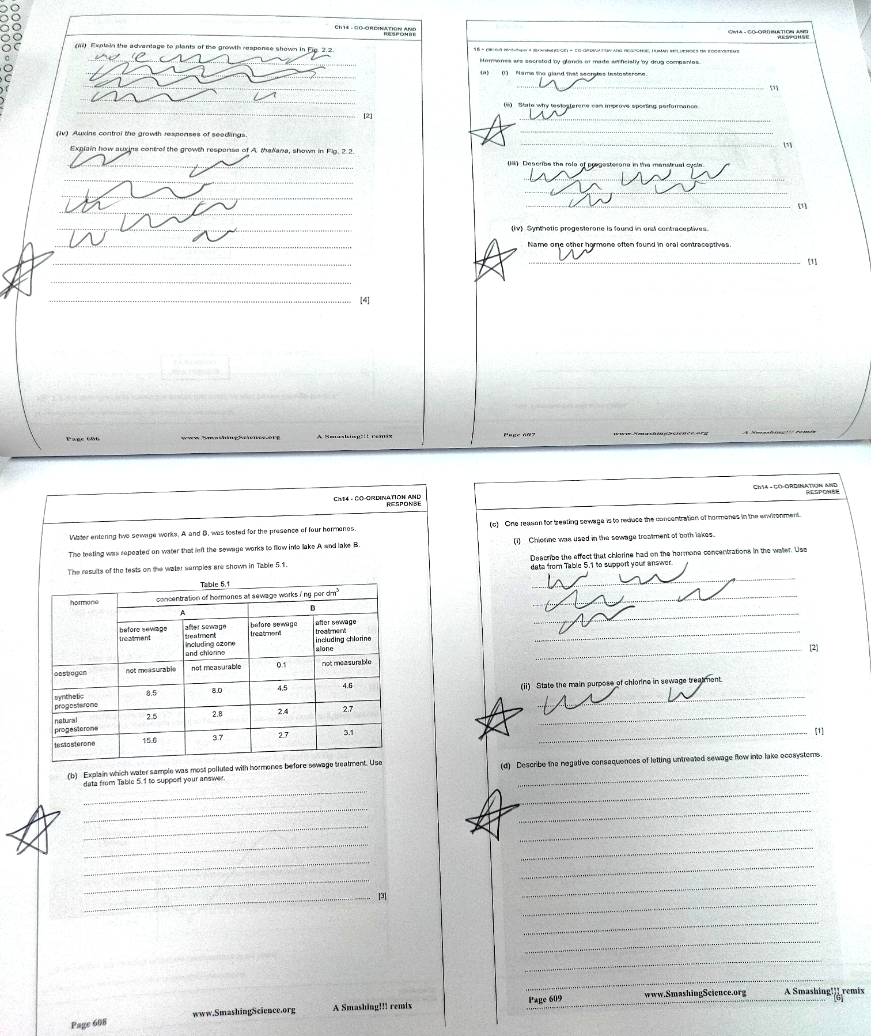
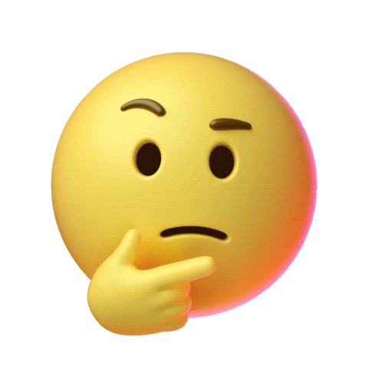
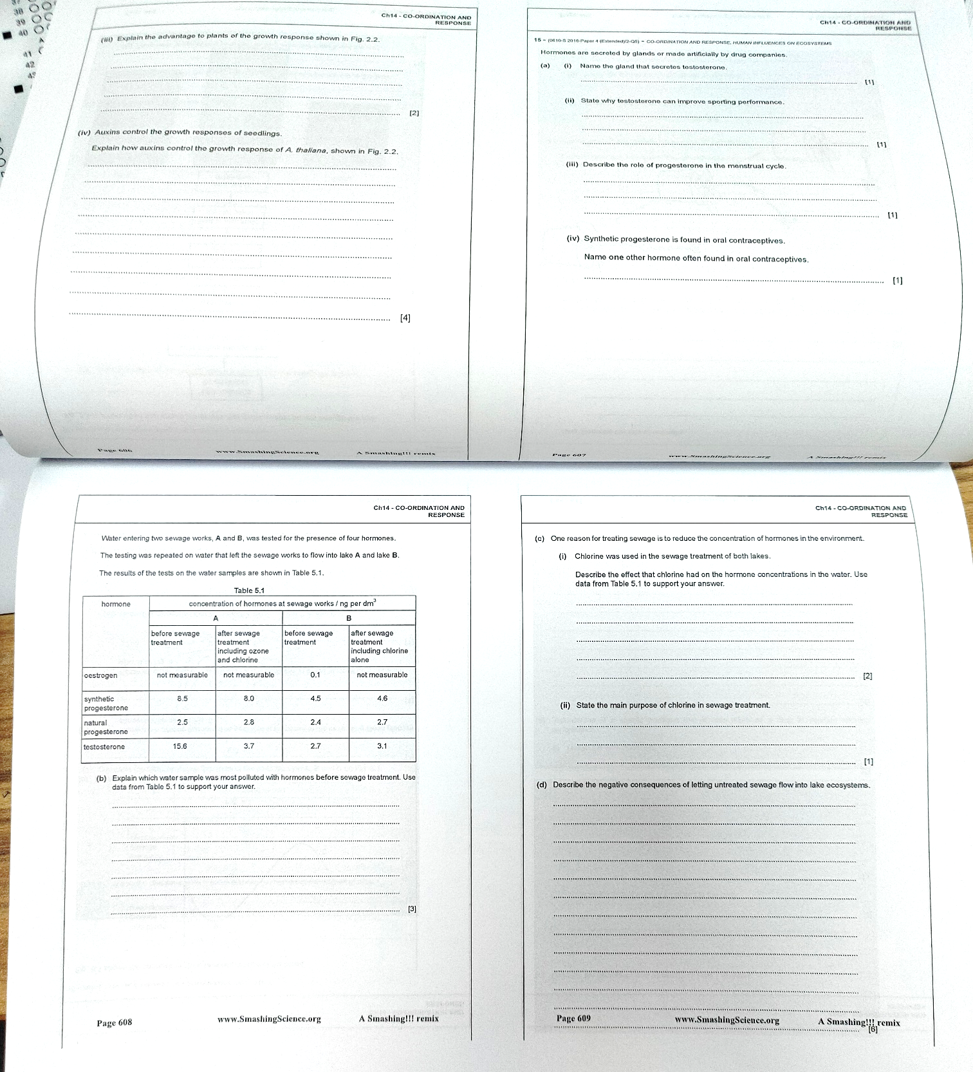
2. Take a whole double page section and answer from memory in black ink
Questions you definitely can’t do, or are unsure about, mark with a star

Slide 7
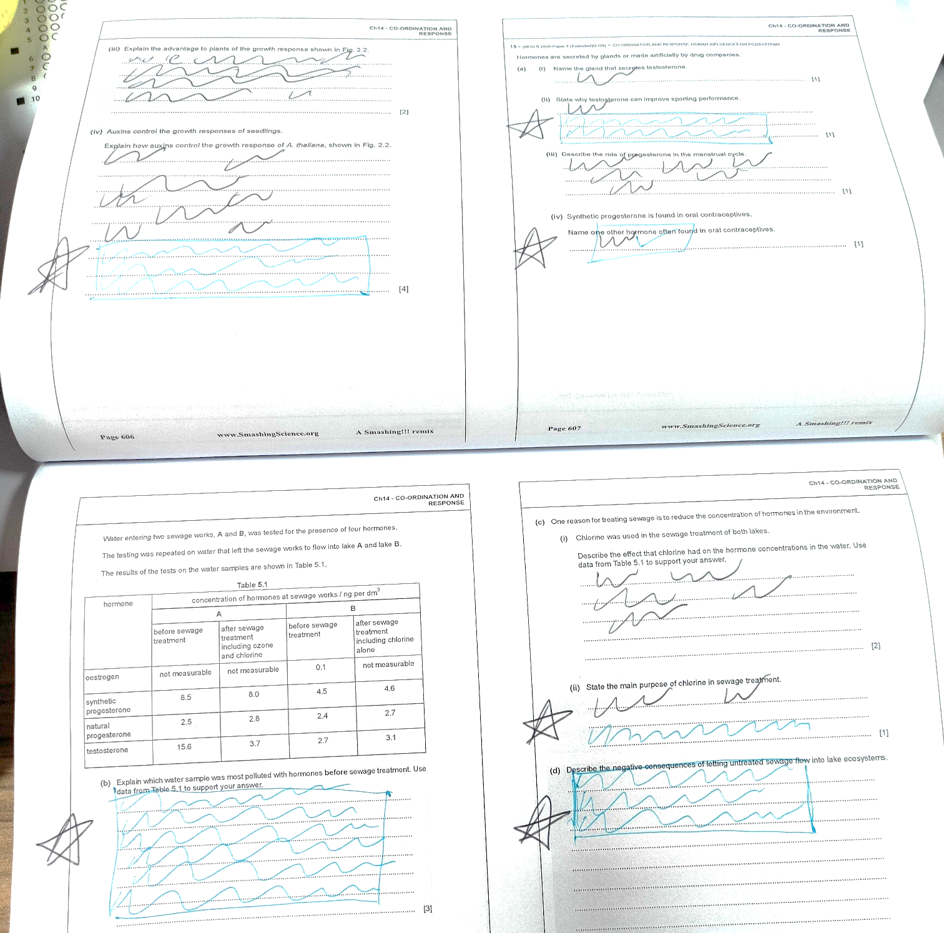
3. In blue ink, using your notes and a textbook, complete unfinished questions

Slide 8
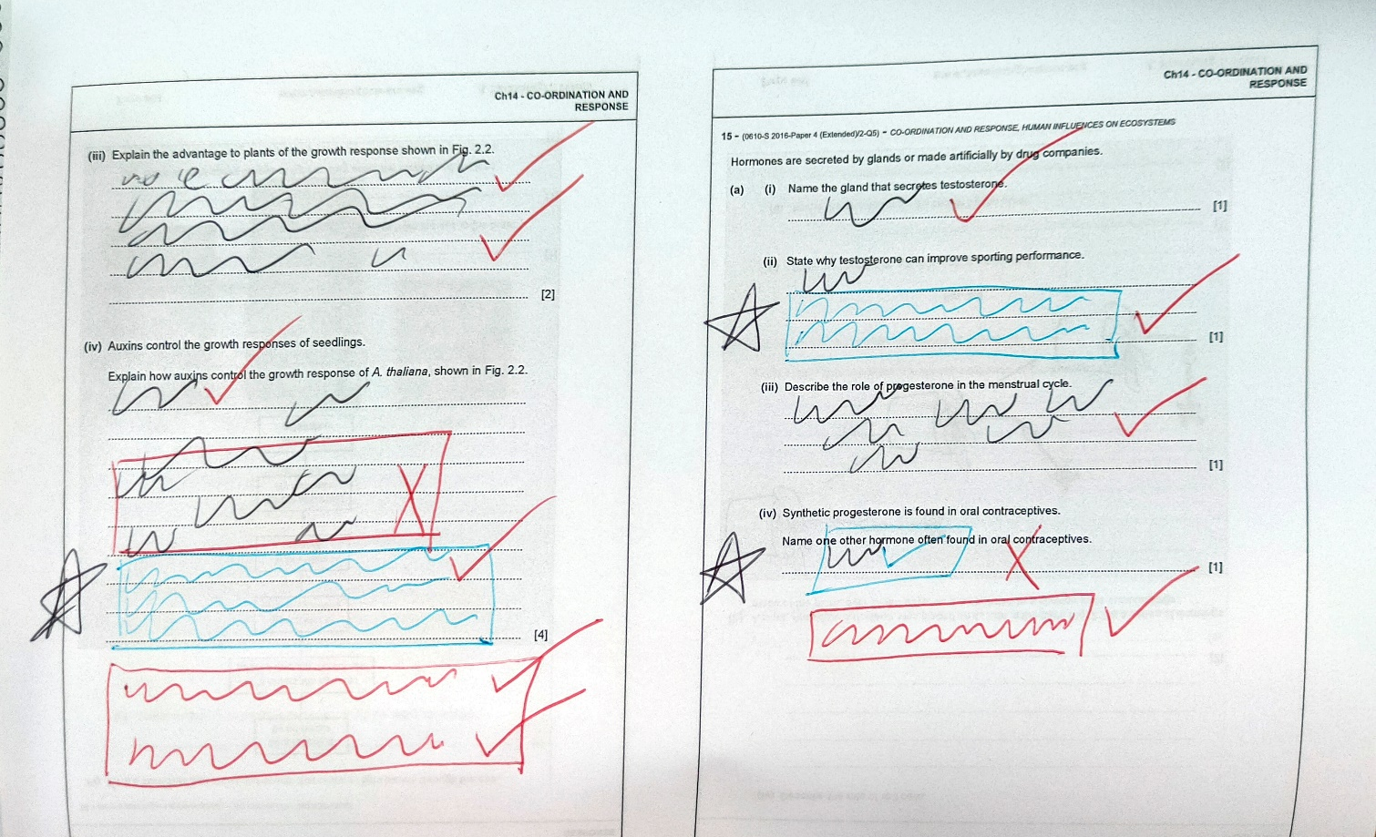
4. Using the mark scheme, check your answers, write out missed marks, in red ink

Slide 9
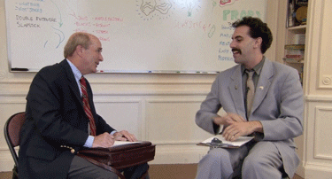
All of the writing in red is the most important to concentrate on
If the things you have written out don’t make any sense, ask your teacher and they can explain it to you

Slide 10
Revising for each end of topic test (and exams)
Read notes + textbook. Then put books AWAY (5 mins)
Take 2 pages of questions (in black) – COMPLETE answers!!! From memory (25 mins)
THEN for incomplete or unknown Q’s – Use notes + textbook to help you and write in blue ink (10 mins)
Use mark scheme, check answers. Missing marks are added in red ink (10 mins)
TOTAL : 50 mins
Everything in red is the most important for larger exams

Slide 11
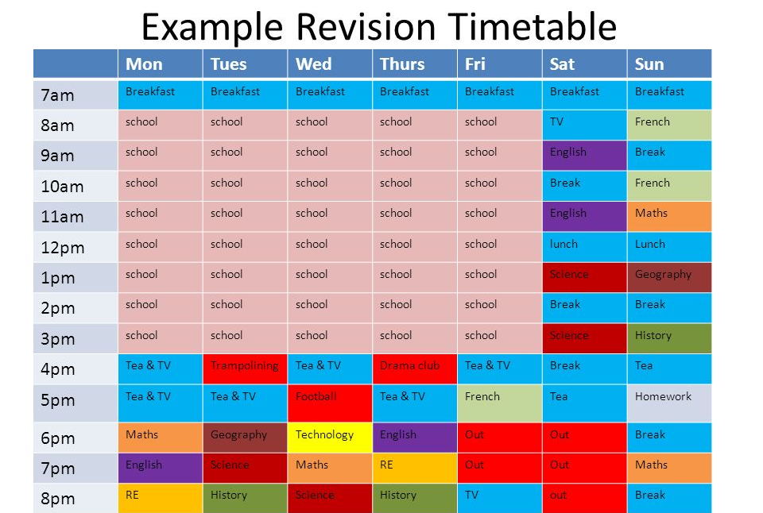

Slide 12
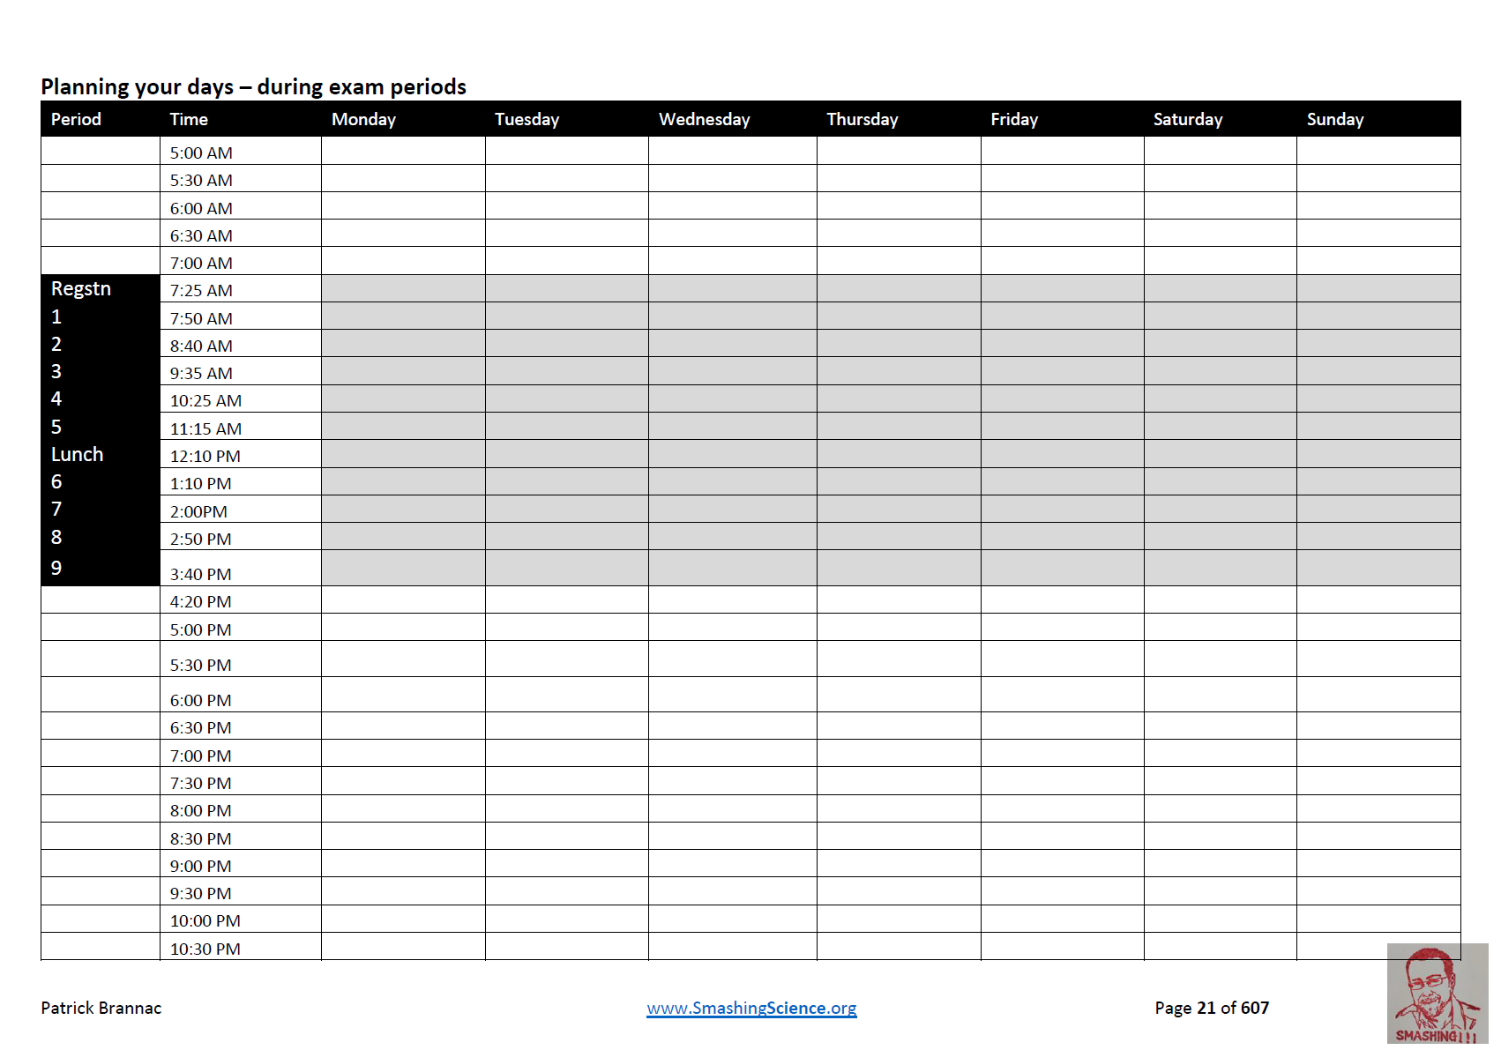

Slide 13
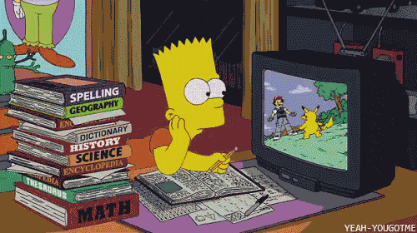
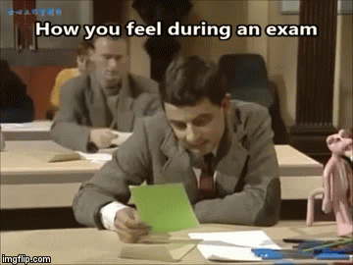
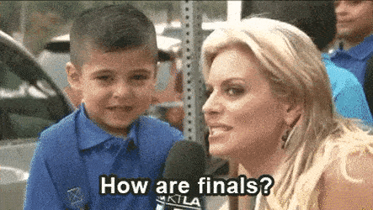

Slide 14
