Slide 1
Making a lasting impression
Introducing the EXCEPTIONAL STRETCH AND CHALLENGE PART OF THE COURSE:
The basics to a good presentation

Slide 2
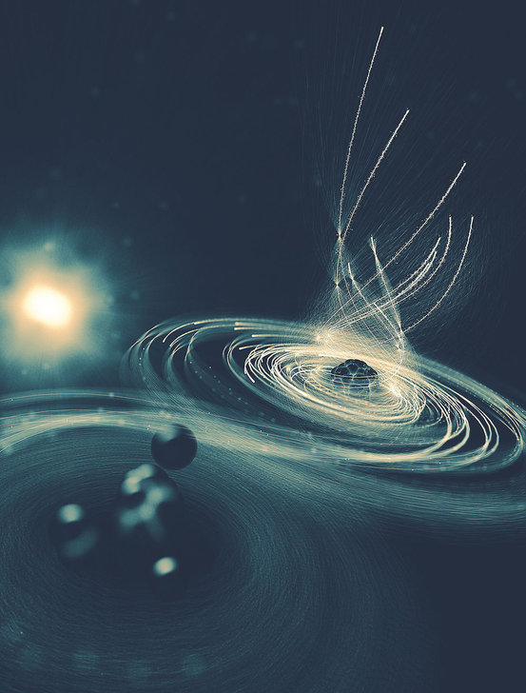
What could this be?

Slide 3
X-ray flash knocks so many electrons out of the iodine atom (right) such that it pulls in the electrons of the methyl group (left) like an electromagnetic version of a black hole, before finally spitting them out.
(From: https://www.livescience.com/59307-molecular-black-hole-created.html Accessed on at 10:48 06/19/2018)

Slide 4
Basic Rules:
Keep your points short
(Use interesting pictures and images instead!)
http://fox8.com/2018/05/23/meet-big-jake-and-thumbelina-the-tallest-and-smallest-horses-in-the-world/

Slide 5
Present questions on your slides
https://awesomejelly.com/wp-content/uploads/2016/06/sphinx-riddle.jpg

Slide 6
Use QR codes to share your presentation

Slide 7
Don’t overload your presentation with information (or make the text too small)

Slide 8
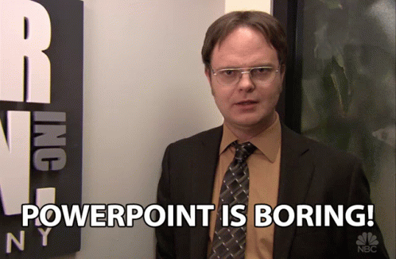
Try not to simply read from your power point
Your slides should be used to show visual information
And KEY POINTS ONLY

Slide 9
Or your website
For the version available everywhere
https://www.smashingsciencecn.org/igcse-chemistry-caie-0620
For the version available only with a VPN
https://www.smashingscience.org/igcse-chemistry.html

Slide 10
Or anything else with your audience
For a range of online course providers that includes the world’s best universities, like Harvard and Yale
https://www.classcentral.com/providers

Slide 11
Try alternatives to PowerPoint, like Prezi
https://prezi.com/yfvykhi4smsl/water-of-crystalisation/

Slide 12
Try to end on an uplifting positive take home point

